Slide 1
Async Building Blocks
A Streaming Data Drama in Three Acts
Zach Mitchell - flox

Slide 2
Me
Rustacean since 2018
Nix documentation team, working group lead
Software engineer at flox (flox.dev)
Notes:
But enough about me, today I'm just your humble narrator
This story is about a message named Mary

Slide 3
ACT I
Genesis
Notes:
This is "async building blocks" not "async materials science" so we're not going to get into the weeds on any particular topic
There's an example application that goes along with this on GitHub
We'll begin by setting the stage

Slide 4
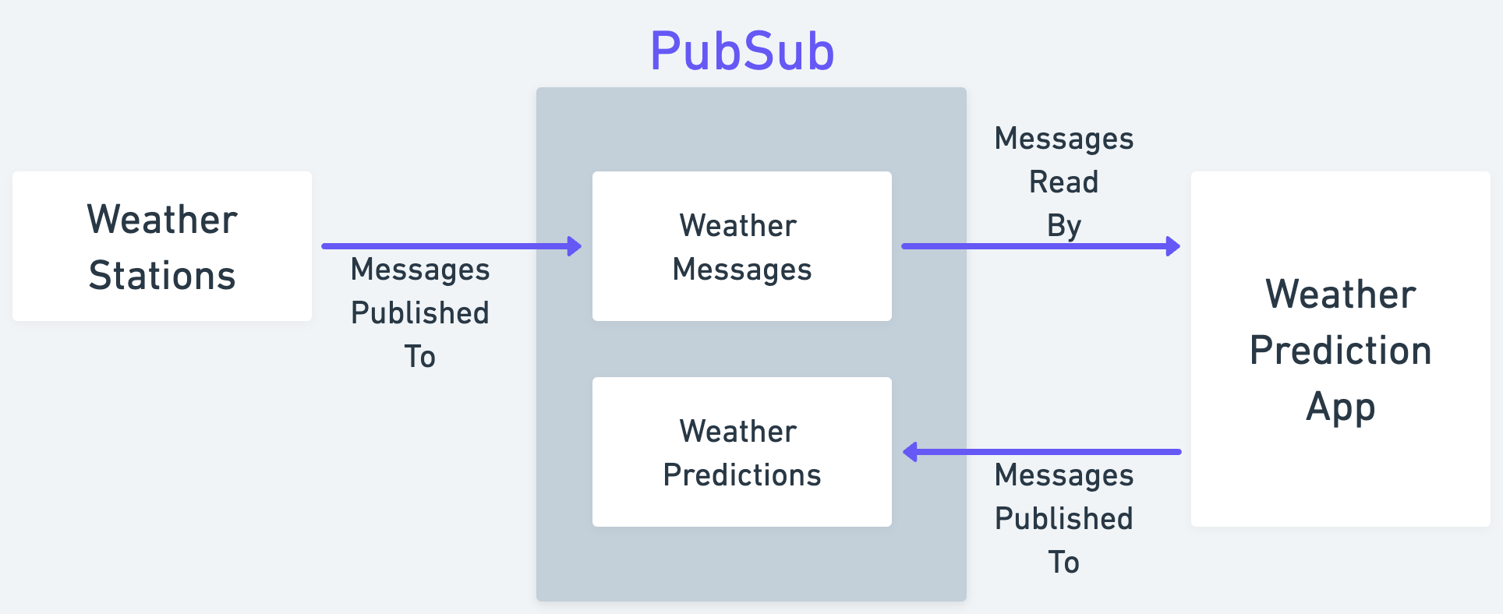
Setting the stage
Notes:
This is the world in which our heroine Mary the Message lives
We have a collection of weather stations publishing measurements to a message queue system called PubSub
The weather stations publish messages to a "weather messages" topic
The messages that arrive there are stored in a queue in the order they arrive
Our weather application reads from this topic (this queue), processes that data, then publishes weather predictions to a "weather predictions" topic

Slide 5
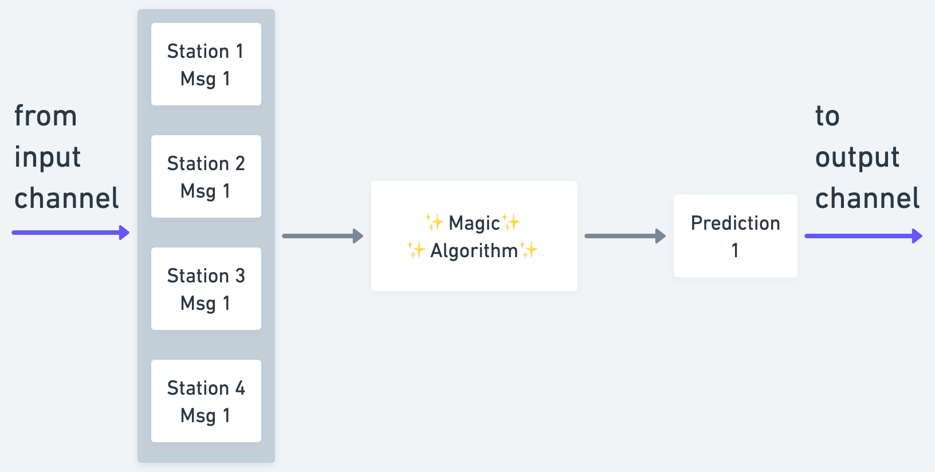
Weather predictions
Notes:
In order to make weather predictions the app needs a message from each station that came from "around the same time"
The app wants to see a snapshot of the entire world
Getting this group of messages will turn out to be kind of tricky
Before we discuss why, let's meet our main character

Slide 6

Meet Mary
"An anthropomorphized cartoon envelope named Mary the Message"
Notes:
A bunch of cool software talks have hand-drawn art, but that requires fine motor skills which I do not possess.
Instead, since AI is taking over the world, I figured I would generate some art with Midjourney.
What I asked for was <prompt>
What I got was "Async Build Blocks: A Streaming Data Drama - brought to you by Tim Burton's A Nightmare Before Christmas"
Mary was just created an instructed to report to Pablo PubSub.
Let's discuss some of the problems Mary will encounter on her way to meet Pablo.

Slide 7
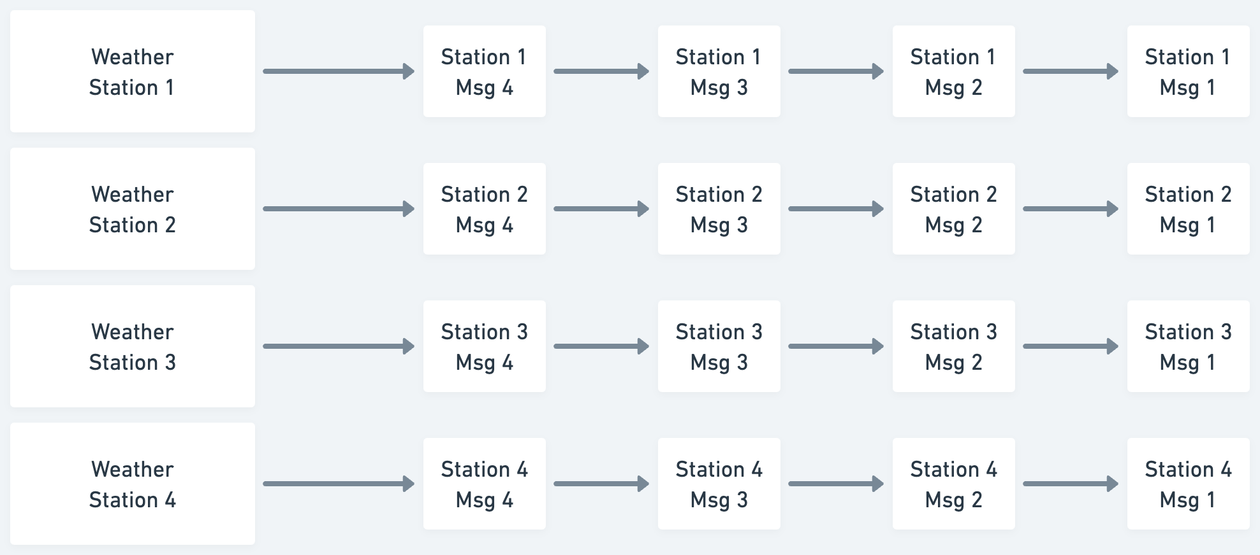

Problem: publishing synchronization
Notes:
Let's say our weather stations are each publishing messages at the same rate (say 100ms)
In an ideal world they would also be publishing in lock step so that "message 1" from each station happens from around the same time
In reality the weather stations aren't measuring at exactly the same time, even if they're doing their best to do so
What it looks like instead is...

Slide 8
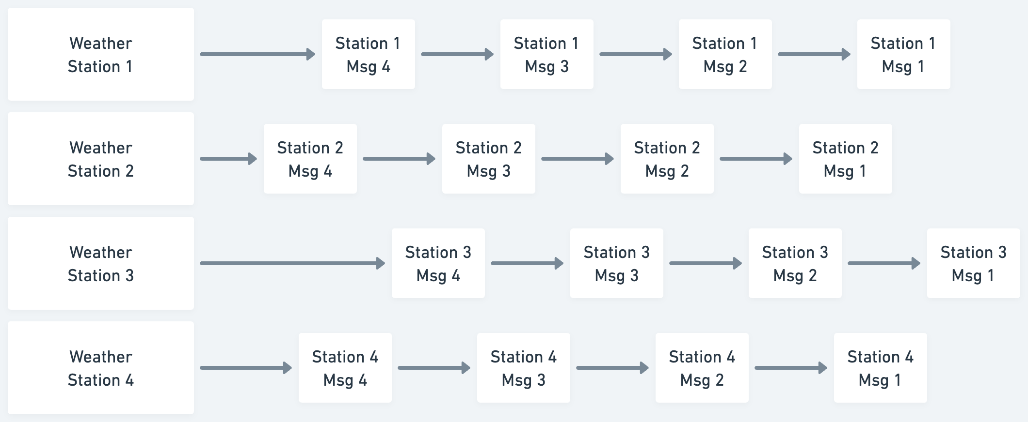
Problem: publishing synchronization
"same time"?
Notes:
One problem you run into here is what counts as the "same time"?
Rather than it being an instant "same time" becomes a window
So, before we've even really started talking about how messages get to PubSub we're faced with a problem
Which of these two messages should count?
The next problem you run into is the fact that between the weather station and PubSub there exists this pesky thing called...

Slide 9
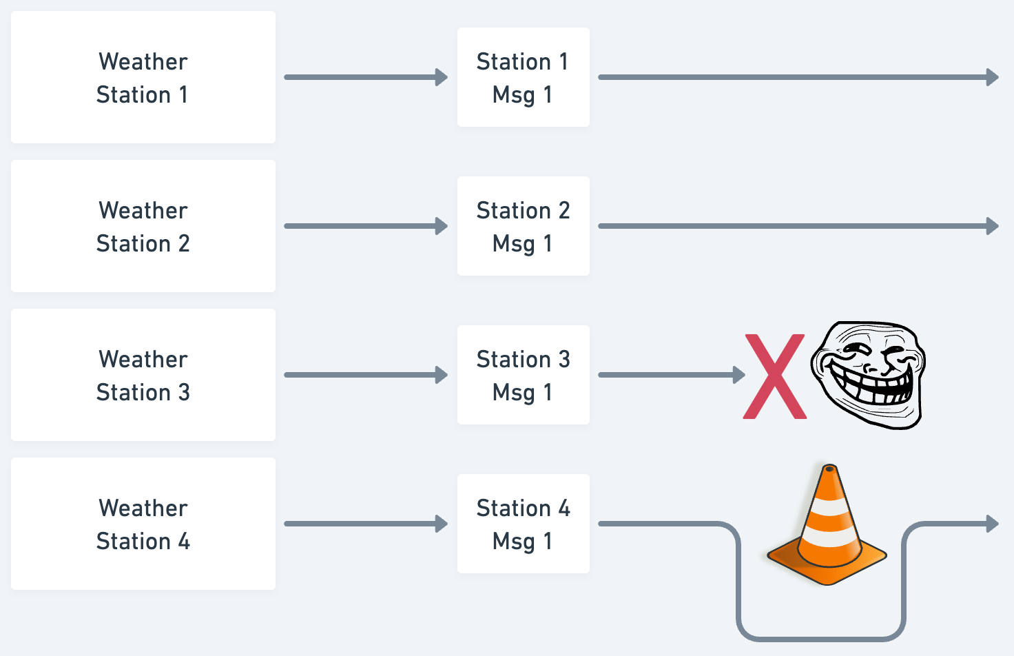
Problem: the internet
Notes:
Some messages will be delivered just fine
Other messages will get lost and need to be retransmitted, you may end up with duplicate messages being delivered
Other messages will take a detour and arrive later than expected

Slide 10
Problem: message ordering
Later
Arrival Time
Earlier
Station 3
Msg 2
Station 2
Msg 2
Station 1
Msg 2
Station 1
Msg 3
Station 3
Msg 1
Station 2
Msg 1
Station 1
Msg 1
Notes:
So, while this is the ideal order that messages arrive in
This is the actual order that they may arrive in after encountering all of these issues
If you just want the next message from each station, you can't just grab the next N messages
There's no guarantee that they'll be the correct messages you're looking for
All of these issues combine to make up the problem space that we're exploring today
But first, let's finally introduce our next character

Slide 11
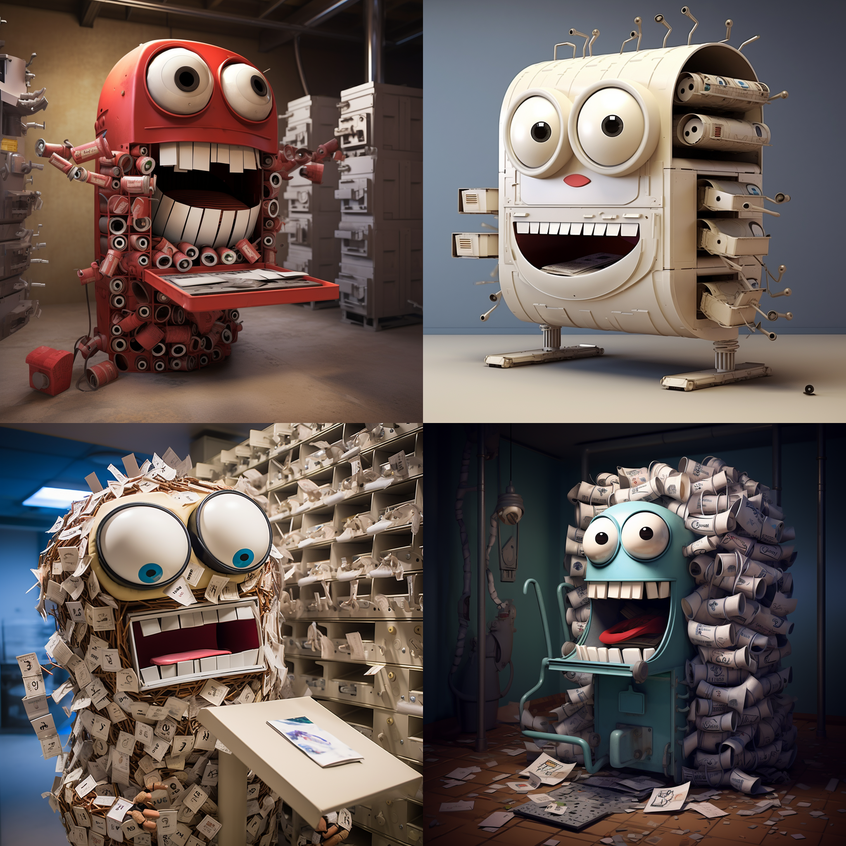
Meet Pablo PubSub
"mail sorting machine made of tubes embedded in a basement, has a mouth and eyes, cute, cartoon, male"
Notes:
Informed by my previous result, I tried being more specific this time, I even asked for it to be cute
I was going for a bunch of pneumatic tubes like you'd see at the bank or pharmacy drive through
What I got instead was something that just happened to be cutely horrifying

Slide 12
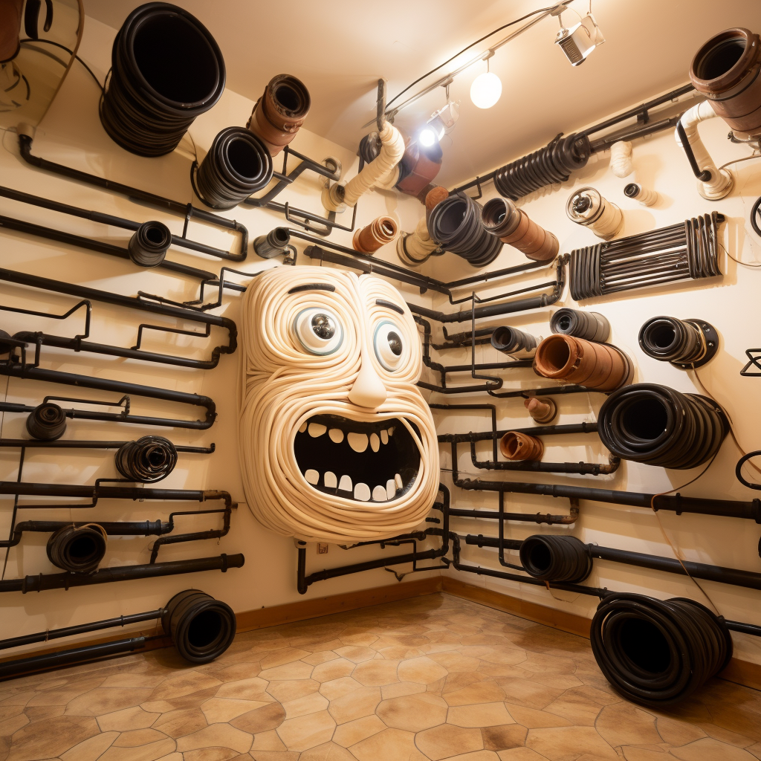
I give up, meet Pablo PubSub
Notes:
Mary arrives at PubSub
Pablo: "Hey! What can I do for you?"
Mary: "I have some weather data to deliver, where should I go?"
Pablo: "Ah! You're looking for the weather app. I'll point you in the right direction and if you get lost along the way I'll just send another copy."
Mary: "What do you mean if I get lost? Wait, and what do you mean you'll send a copy?"
Pablo: "All kinds of stuff can happen on the mean streets of the internet."
Pablo: "Messages get lost or delayed all the time. We keep copies around in case something happens and a message doesn't arrive on time."
Pablo points at a bunch of cloning chambers.

Slide 13
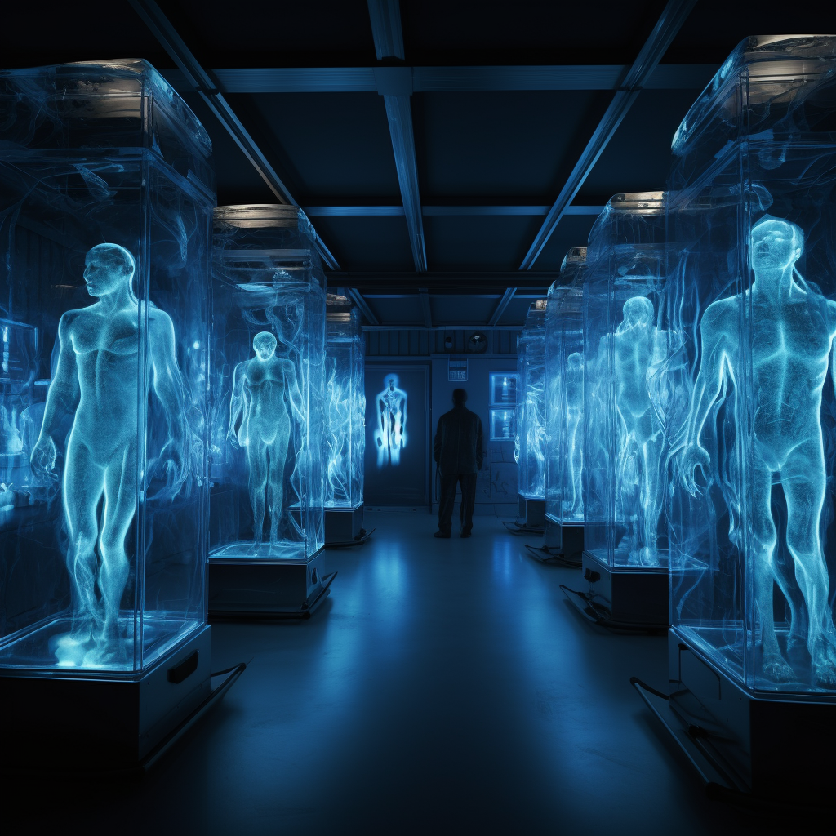
Mary has an existential crisis
Notes:
At this point Mary has an existential crisis.
"How do I know I'm the real me?"
"Am I the original me"
"Are there more of me out there already?"
Pablo, looking exasperated: "Okayyy, time to go" and pushes her out the door

Slide 14
ACT II
The App

Slide 15
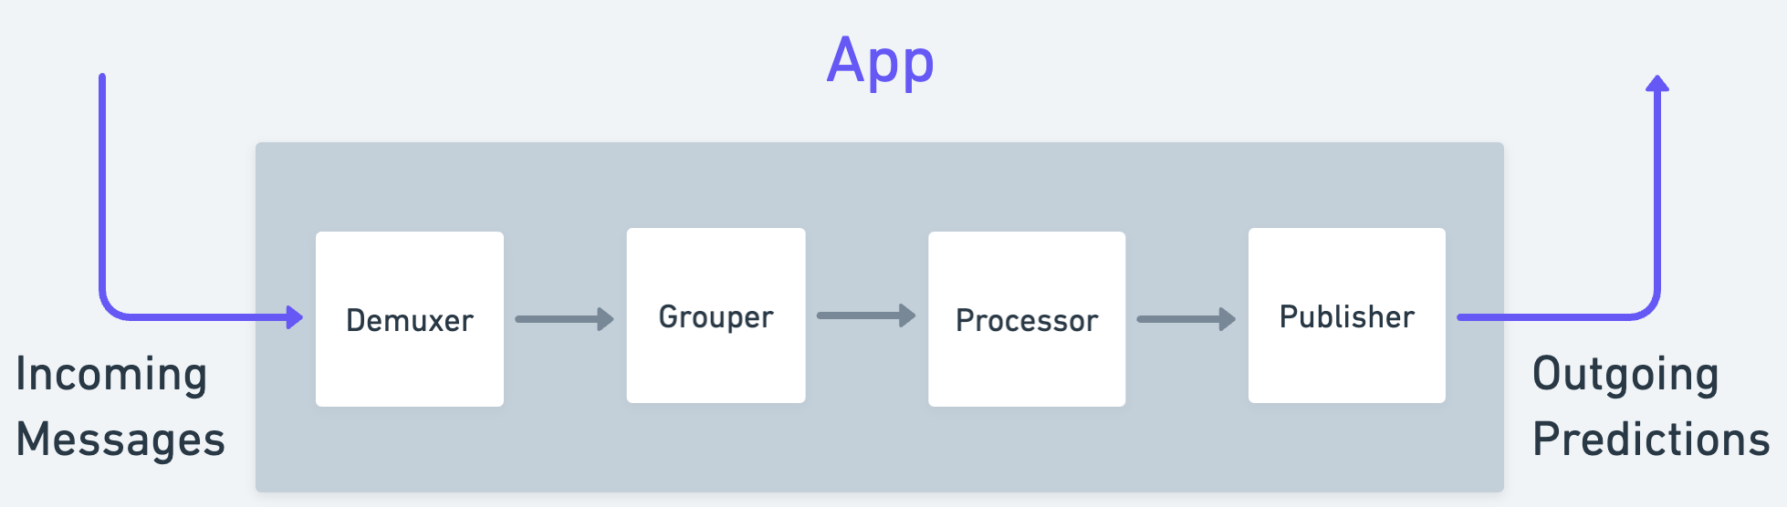
App overview
Notes:
This is an overview of what the app will look like
We have incoming messages that are all mixed together
These incoming messages will be somehow handled by a component called the demuxer
"Demuxer" meaning "demultiplexing"
This part organizes messages into some form that's more convenient for the rest of the system
Then those messages will be placed into groups, like I mentioned earlier
The processor does the weather prediction
The publisher sends our predictions back to PubSub to be consumed by some other application

Slide 16
Modeling incoming messages
Something that produces a sequence of messages
Synchronous -> Iterator
Asynchronous -> Stream
Low-level interface is in futures::Stream
Stream-handling goodies are in futures::StreamExt
Stream-producing goodies are in async_stream
Notes:
In a synchronous world a sequence of items is represented by the Iterator trait
In the asynchronous world you model this with a Stream
My mental model for a stream is essentially an iterator that returns Futures
The iterator trait provides all these combinators like "take", "skip_while", "and_then", that kind of thing
All of those combinators for Streams are provided by the StreamExt trait

Slide 17
Problem: message ordering
Messages are out of order
Messages arrive late
All I want is the next set of messages!
Solution: buffering!

Slide 18
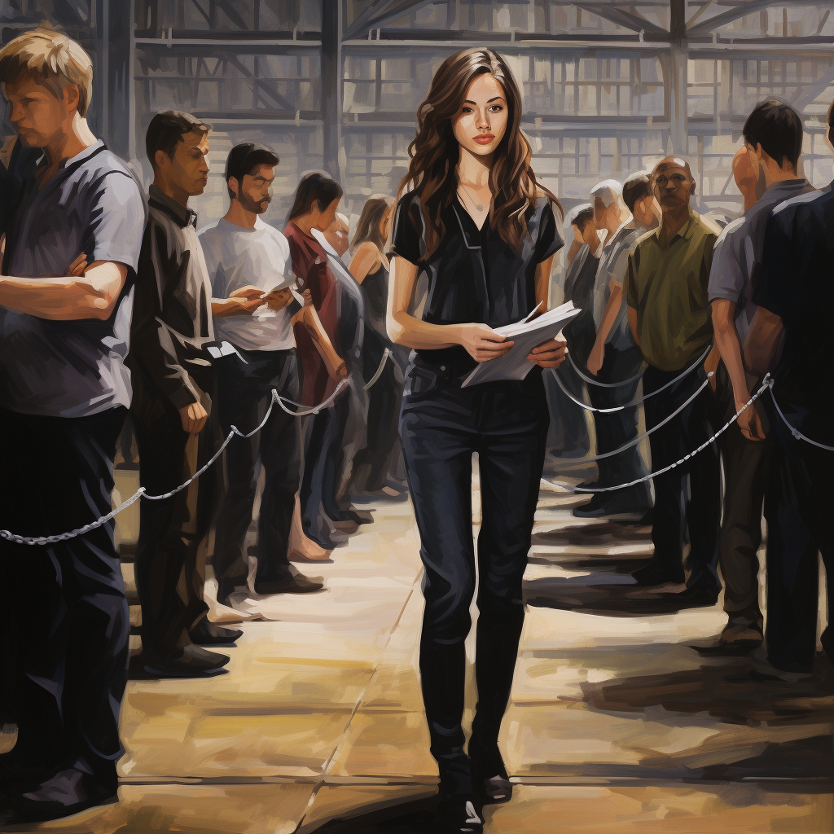
Meet Beatrix Buffer
"A woman with a clipboard and a lanyard keeping several people in orderly lines separated by stanchions in an industrial warehouse"
Notes:
Without further ado, meet Beatrix Buffer
Mary arrives at the weather application and sees a woman keeping messages in neatly ordered lines
But, before Mary can introduce herself to Beatrix Buffer, a man blows a whistle and runs over to her
We'll get to that character in a minute
The horror in this example is not as apparent
I asked for stanchions, which are those things that make lines at the movie theater, the airport, etc
What I got instead is a chain
Not just any chain, but one that's not connected to anything in particular
Except for maybe this man's belt,
And, unfortunately, this man's crotch

Slide 19
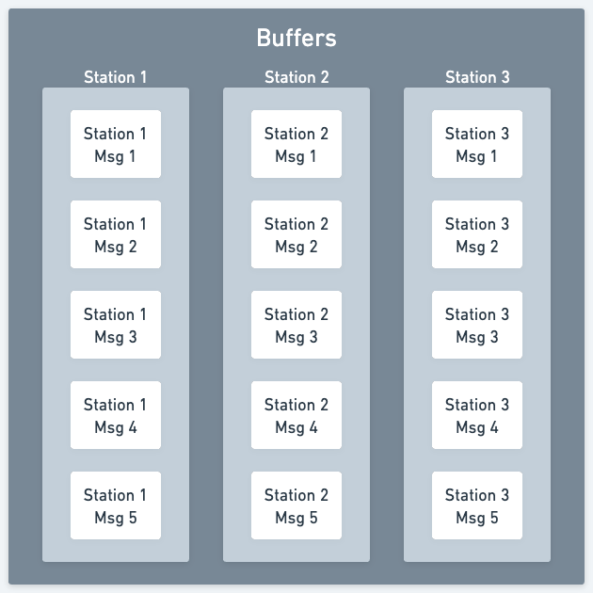
Buffers
type Buffers =
HashMap<
u8, // Weather station
VecDeque<WeatherMessage>
>
Notes:
- We're going to keep the messages in each buffer sorted by creation time

Slide 20

Meet Dino Demuxer
"Demux" = "demultiplex"
Ingests the mixed message stream
Sends messages to the correct buffer
Beatrix maintains order within that buffer
???
Notes:
You don't need to see the prompts anymore, just trust that I gave it solid try
These children appear to be pleading
This arm is disembodied
That child's lower body is made out of basketball sized baseballs
Dino runs over to Mary:
Dino: "quick, which station did you come from"
Mary: "uhhhh, station 1!"
Dino: "Over there, hustle, hustle!"
Mary hurries over to the correct line as Dino talks into a walkie talkie and hurries her over
Dino sends her through an obstacle course because it builds character

Slide 21

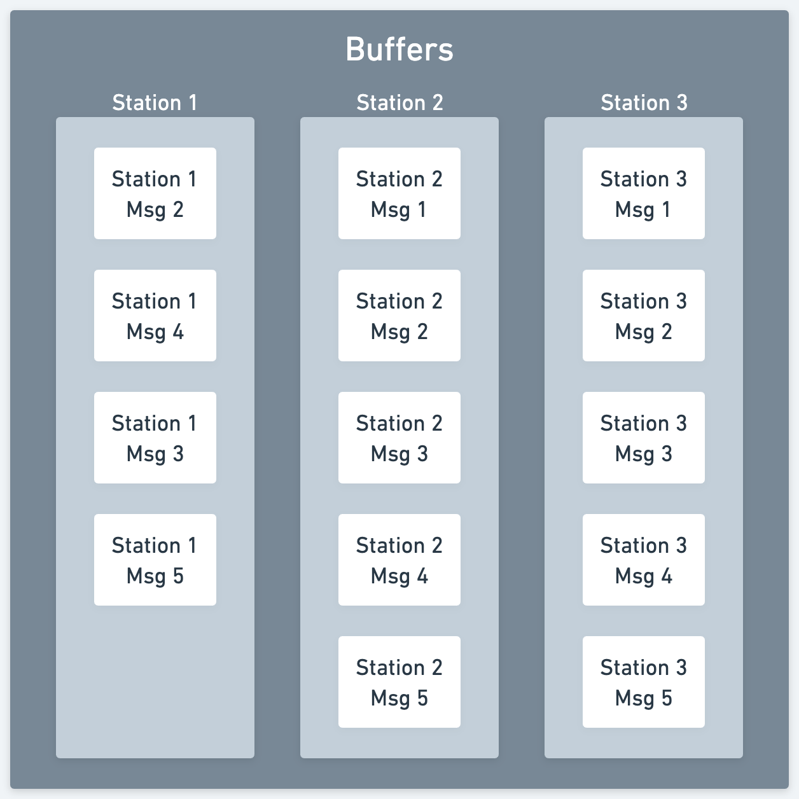

Message insertion
Dino brings the message to the correct buffer
Notes:
We start out with Station 1's buffer missing a message
Dino brings a message to Beatrix
Beatrix places that message in the correct spot in the buffer

Slide 22
Message insertion
Beatrix puts the message in the correct order
Notes:
- The other thing that Beatrix does is discard any duplicate messages that arrive

Slide 23
Problem: coordinating buffer access
Dino tells Mary to wait with Beatrix
Beatrix puts Mary in the right position in line
Greta Grouper pulls messages out of the buffer
How do we prevent a race condition?
Notes:
We're Rust developers
We have principles, and compiler enforced moral superiority
We're not out here raw-dogging mutable pointers or letting the quantum fluctuations of the universe determine winners and losers
We're going to use...

Slide 24

Meet Mitch Mutex
Arc<Mutex<Buffers>>
Notes:
At applications startup, Mitch Mutex hands a walkie-talkie labeled "ARC" to Dino and Greta, keeping one for himself
Anyone that wants to access the buffers needs to OK it with him first
He's supposed to be a referee blowing a whistle, idk blame Midjourney
Dino starts spamming the walkie talkie
Mitch: blows whistle, "Giving the Mutex the business, task is blocked until further notice"
It's not your turn Dino, chill out
We have our buffers behind Arc<Mutex<>>
There's actually a tokio::mutex
Which one should you use?
There are magic words for these kinds of situations.
Say it with me: "it depends"
Congratulations, you're all senior engineers now
Enjoy your raise

Slide 25
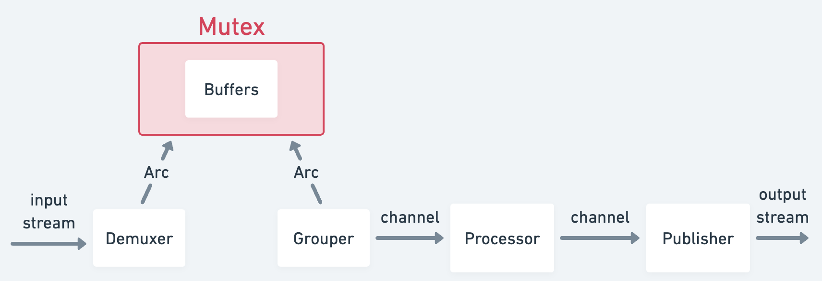
YOU ARE HERE
Notes:
At this point we've started to discuss some details of the system
Let's take a more granular look at the application

Slide 26
Problem: parallel execution
Futures can execute concurrently on a single thread
Sometimes you still want them to execute at the same time
Solution: tasks
let demuxer_future = demuxer(...);
let demuxer_handle = tokio::spawn(demuxer_future);
...(other tasks)...
futures::select!{...};
Notes:
What we want is to run different components of our system independently
A multithreaded runtime like tokio can run tasks on separate threads -> parallelism
Each component creates a future
We'll create a task for that component by calling "tokio::spawn"
The task floats off into the ether of the runtime and you're left with a handle to it
You'll then await that handle
If you want your application to run forever, you just make that future run forever
We'll use the "futures::select" macro to await all of our tasks at the same time

Slide 27
Problem: grouping messages
Prediction algorithm wants a snapshot of the world
We need messages from the "same time"
Lots of tricky details here
How long do you wait for late arrivals?
"Same time" doesn't exist
etc
Notes:
A large part of my last job was coming up with robust solutions to this exact problem
We won't go into any of that, we'll just grab the oldest message from each station, assuming they were produced at the same time

Slide 28
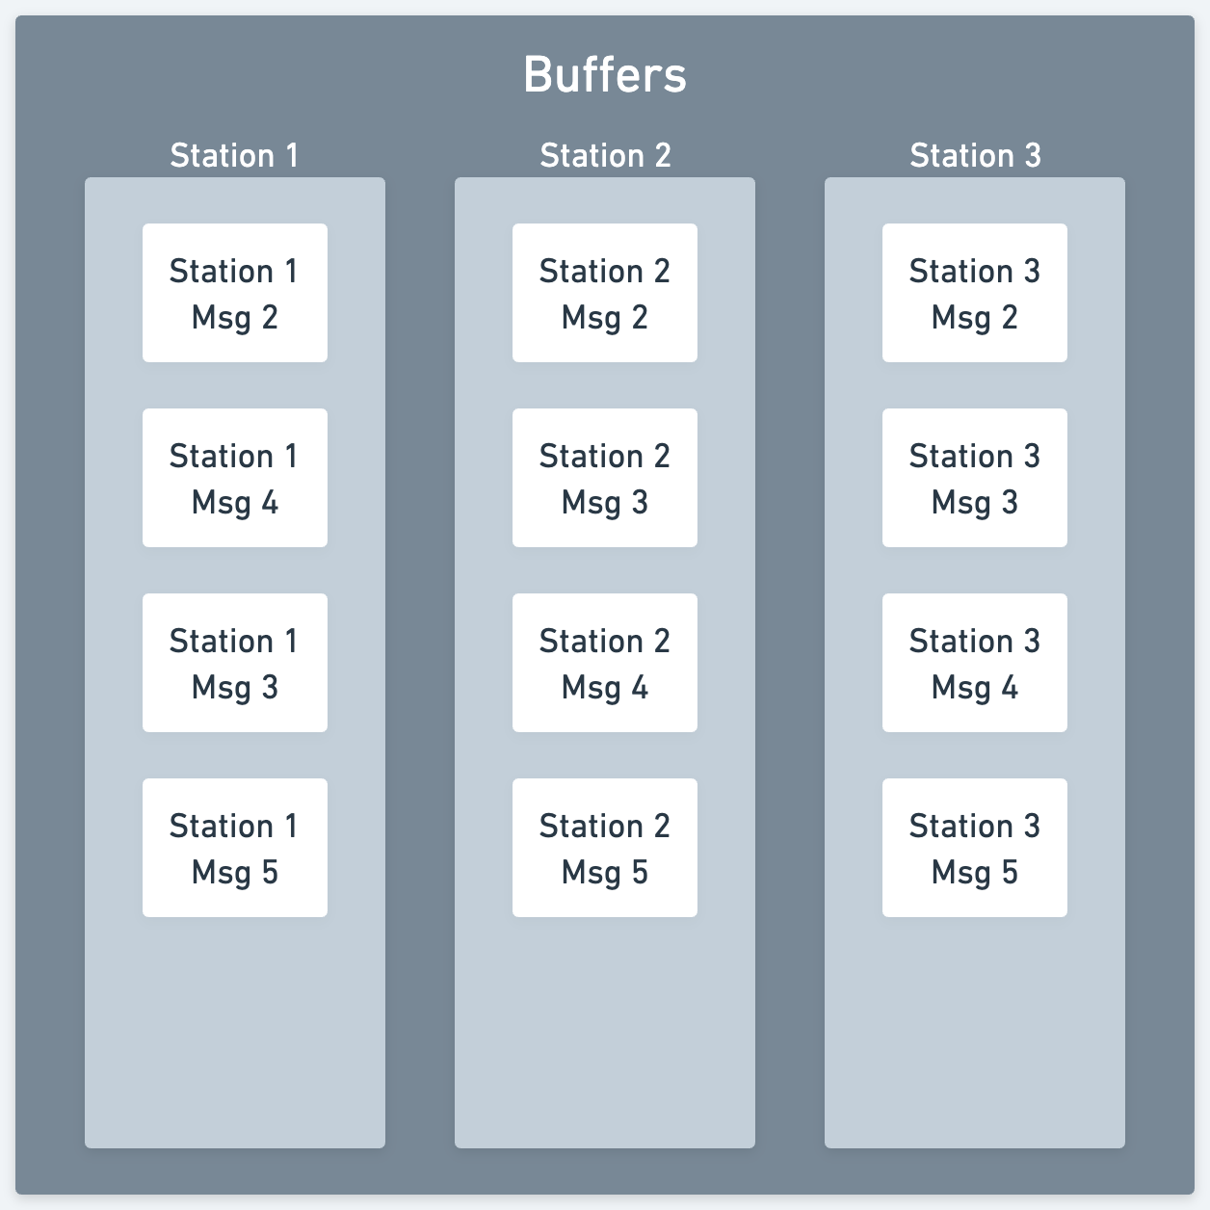
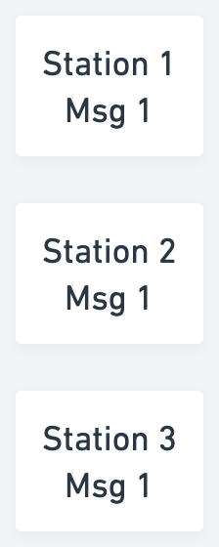
Problem: grouping messages

Slide 29
Problem: grouping messages
Station 1
Msg 2
Station 2
Msg 1
Station 3
Msg 1
Station 1
Msg 3
Station 2
Msg 2
Station 3
Msg 2
🕝
Station 1
Msg 4
Station 2
Msg 3
Station 3
Msg 3
Station 2
Msg 4
Station 3
Msg 4
Notes:
The first thing we're going to do is wait
While we're waiting a message arrives
We keep waiting until time runs out
Once that's over we pull out the oldest message from each buffer to form our group

Slide 30

Meet Greta Grouper
Pulls messages out of the buffers
Packages them into a group
Sends that group off for processing
Notes:
Greta asks the first message in each line to step forward
She ushers them all to stand together within a spot on the floor marked out in tape
She asks them all to stand there for a moment
Backs away, then slams a button on the wall
A robotic arm descends from the ceiling, wrapping the messages in plastic wrap
A blue portal opens on the wall next to Gwen
The floor swings up to catapult the group of messages through the portal
Sick
Let's discuss what this portal is all about

Slide 31
Problem: getting data out of tasks
A task isn't a function, how do you get data out?
One option: write to an external data structure (e.g. demuxer -> buffers)
Another option: channels!
Basically a computer wormhole
futures::sync::mpsc::channel
Notes:
With a function you call it once and you get a single return value once the function completes
A task is a (potentially) long living thing that we want to continuously get data out of
What are our options?
We use an Arc<Mutex<T>> to store some data somewhere in the demuxer
We can also use channels
I get an end to send data into
You get an end to pull data out of

Slide 32
YOU ARE HERE

Slide 33
ACT III
Metamorphosis
Notes:
- Things are about to get weird for Mary and her cohort of messages

Slide 34
YOU ARE HERE

Slide 35
Making predictions
Notes:
This is pretty straightforward
We take a group of messages, run it through the algorithm, and get a prediction
We won't go into the details of the weather prediction algorithm because, like all algorithms, it's magic

Slide 36

Meet The Processor
Notes:
This one just came out dope and not horrifying so let's all give Midjourney a round of applause
The shrink-wrapped group of messages is ejected unceremoniously from the other end of the portal, landing at the feet of the entity known as The Processor
It sits on a throne made of clouds with a book on its lap
On the spine, embossed in gold letters are the words "THE ALGORITHM"
P: "Hello, I'm sure your journey here has been strange and perilous"
P: "However, nothing will have prepared you for the choice I now lay before you"
P: "If you consent, you will ascend to a higher state of being, a Prediction"
P: "You will cease to exist individually, but the Application will fulfill its purpose and the future weather will be known"
P: "What say you?"
M: "Can't we just tell you what our data says instead?"
P: "Sure, but that is decidedly less rad"
M: Looking at the other messages, "He makes a good point, that would be less rad"
The messages look at one another, giving each other solemn nods
P: presses a button on the arm of his throne, a beam of light cascades down onto the messages and they meld into a single glowing orb of light known as a prediction
A door opens on the other side of the room and the prediction floats through it

Slide 37

Meet The Prediction
"A glowing ball of light with several faces"
Notes:
Given this prompt, things could only go well, right?
Midjourney gives you four examples for each prompt, these were all equally terrifying so here you go

Slide 38

Meet Padma Publisher
Notes:
The floating orb of light exits the door and finds itself and a loading dock
There's a woman, smiling and holding a small brown paper bag
The orb floats over to her
Padma: "Hello there, aren't you a sight to behold"
Prediction: "I can't tell, there are no mirrors"
Padma: "Well, you're going to head back to Pablo now, why don't you take this with you for the trip?"
Padma holds out an open brown paper bag
Prediction peers inside and sees a peanut butter and jelly sandwich and some orange slices
Prediction: "We have ascended to a higher state of being and no longer require food to sustain our physical form."
Padma: "I know, it just makes me feel useful. Off we go!"
Prediction floats into the back of Padma's truck
With regards for Midjourney I'll only point out two things:
The windshield is somehow behind Padma. What could go wrong?
Her left hand is not connected to her left arm.
For those of you that are also D&D nerds, yes, Padma is using the Mage Hand spell.
Having ascended to a higher state of being, Prediction can now see the fabric of reality and can see all of the tasks executing in parallel
They float through the internet, unbothered by all of the perils of network congestion, misconfigured servers, and nefarious BGP hijacking incidents
Prediction arrives back at the message processing facility, making their way to Pablo
Prediction: "Pablo, we have traversed the internet and survived, we are ready for what comes next.
Pablo: "Well, us-east-1 is down for the moment, so I guess you'll have to stick around with me for a while."
A face made of pneumatic tubes embedded in a wall and a hivemind inhabiting a floating orb of light?
Truly a friendship meant for the ages

Slide 39
FIN

Slide 40
Resources
Me
tinkering.xyz
https://hachyderm.io/@zmitchell
https://github.com/zmitchell
Code
https://github.com/zmitchell/streaming-weather-app
Slides
https://github.com/zmitchell/talks

